Slide 1

Exploratory Data Analysis of Product Failures
Phase 1: Summary of Findings

Slide 2
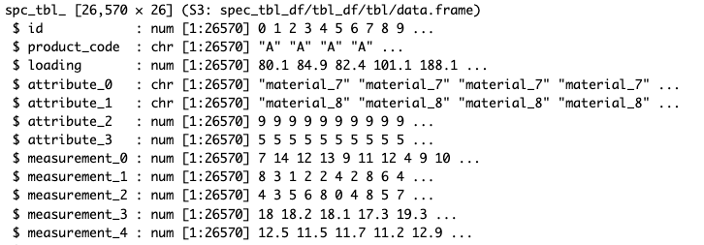
Training Dataset Overview
Multiple variables: product codes, attributes, and various measurements
26 columns and 26,570 rows
16 continuous variables, categorical variables, and failure labels

Slide 3
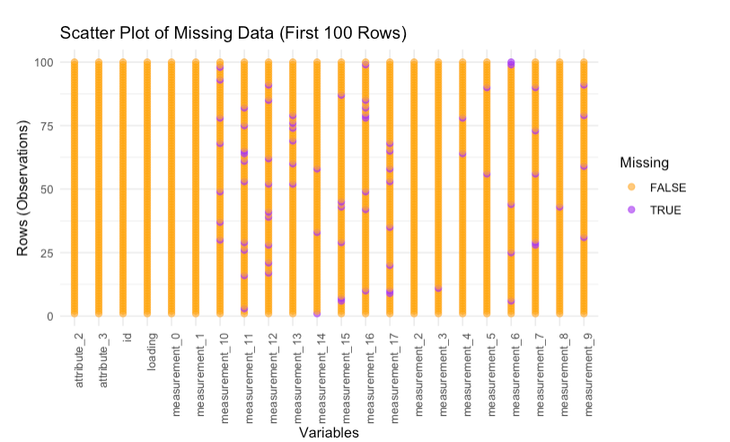
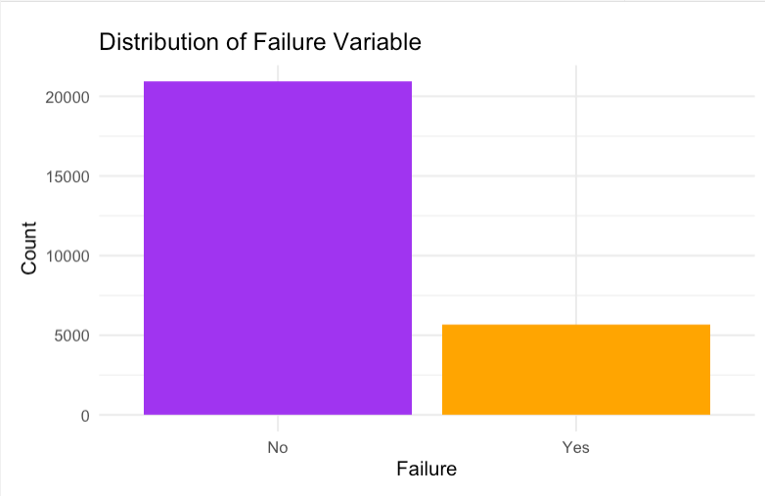
Missing Data & Failure Distribution Overview
Several columns, particularly measurement variables, contain missing data
Missing values are significant and will need to be addressed in later phases
Left visual represents only the first 100 rows due to the extent of missing data
The failure variable is highly imbalanced, with 'No' failures significantly outnumbering 'Yes’
This imbalance may impact model performance and could require rebalancing

Slide 4
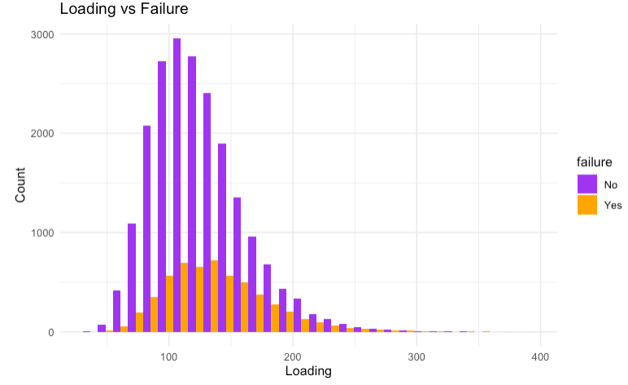
Distribution of Loading Variable
The loading variable follows a fairly normal distribution with some outliers
This could be a potential predictor for failure in later modeling phases

Slide 5
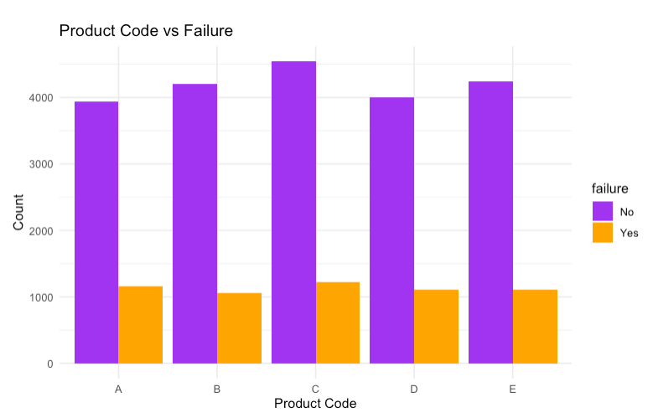
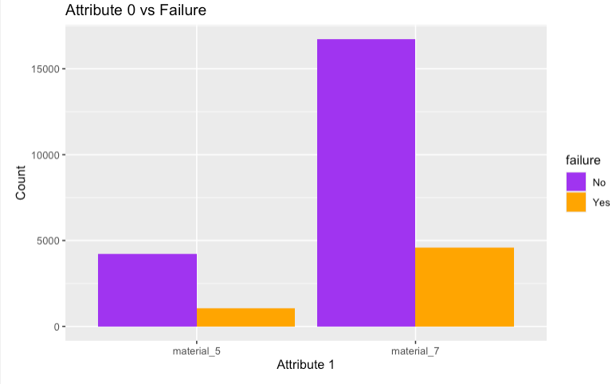
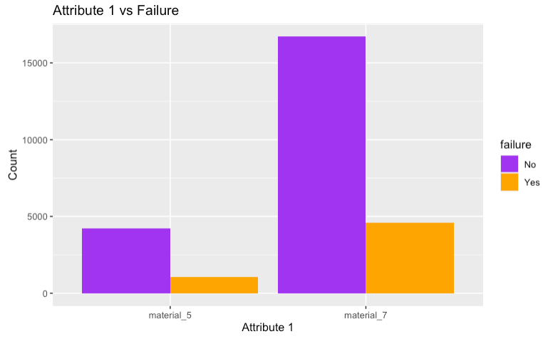
Categorical Variables vs Failure
Product code shows distinct differences in failure rates across categories
Attribute 0 displays significant variation, with certain categories more prone to failure
Attribute 1 shows some variation in failure rates, though less pronounced

Slide 6
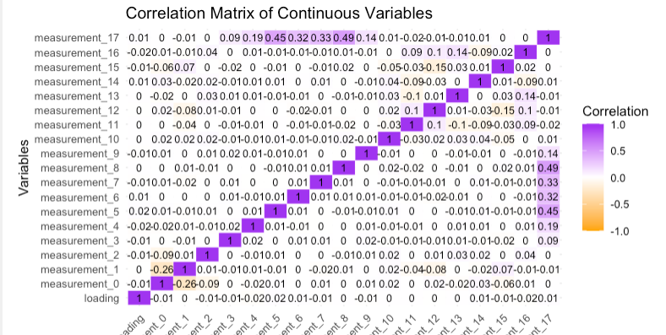
Correlation Matrix of Continuous Variables
Moderate correlations between certain measurement variables suggest possible interactions
The loading variable does not show strong correlations with the measurements

Slide 7
Conclusion and Next Steps
Phase 1 identified several potential predictors, including categorical variables like Product Code and continuous variables like Loading
Phase 2 will involve using this data to build multiple models to predict the "failure" variable

